Slide 1
Presentation Title
Presenter, Organization

Slide 2
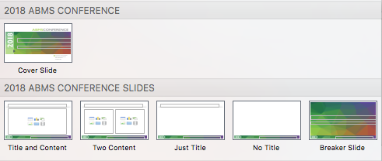
Choose from different content layouts
Fonts:
Headings: Gill Sans MT
Body Copy: Avenir Book
The following slides are samples of each content layout slide:

